Slide 1
رايانش نرم،
هوش محاسباتی
دانشكده مهندسي كامپيوتر
دانشگاه علم و صنعت ايران
mozayani@iust.ac.ir
مقدمه

Slide 2
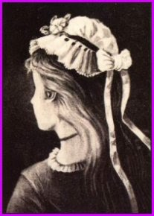
What do you see in the picture?

Slide 3
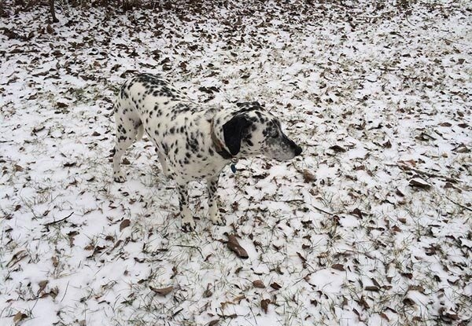
What do you see in the picture?

Slide 4
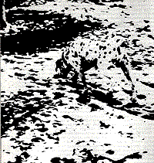
What do you see in the picture?

Slide 5
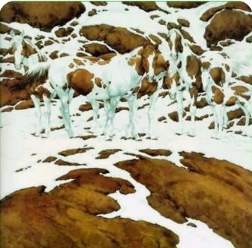
What do you see in the picture?

Slide 6
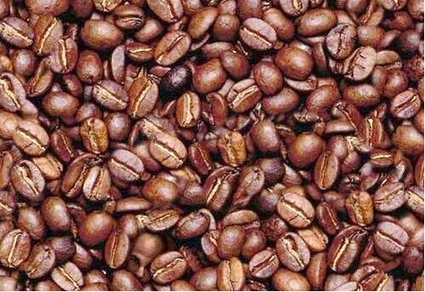
What do you see in the picture?

Slide 7
What kind of science?
Deterministic?
Statistic?
Computational Intelligence
  Artificial Neural Networks
  Evolutionary Computing
  Fuzzy Systems

Slide 8

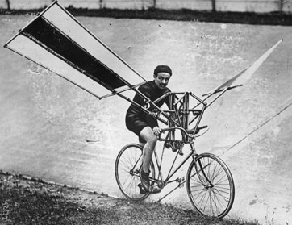

Biological inspiration

Slide 9
HISTORY
1940 – First computing machine
1957 – Perceptron (First NN model)
1965 – Fuzzy Logic (Rules)
1960s – Genetic Algorithm
1970s – Evolutionary Computing
1980s - Neural Computing, Swarm Intelligence
2000s – Deep learning

Slide 10
COMPUTATIONAL INTELLIGENCE
Statement of Problem
Goal: Problem Solving
When underlying structure of the system is unknown, or the system is known but it is too complicated
Given a set of data collected (or measured) from a system, devise a model (by whatever structure, technique, method in CI) that mimics the behavior of that system as ‘good’ as possible

Slide 11
COMPUTATIONAL INTELLIGENCE
Statement of Problem
Making use of the devised model to
  interpret the behavior of the system,
  predict the future behavior of the system,
  control the behavior of the system,
Tasks such as :optimization, approximation, classification, clustering, recognition, reconstruction, detection, generation, …
making money

Slide 12
METHODOLOGY
Step 1: Data Collection
  Experiments or measurements
  Questionnaire
  Magazine
  Public data sets
Step 2: Model Structure Assumption
  IF it is known, SKIP this step.
  ELSE, DEFINE a model structure

Slide 13
METHODOLOGY
Step 3: Parametric Estimation
  Gradient descent
  Newton’s method
  Exhaustive search
  Genetic algorithms (*)
  Evolutionary algorithms (*)
  Swarm intelligence
  Simulated annealing (*)
  Markov Chain Monte Carlo (*)

Slide 14
METHODOLOGY
Step 4: Model Validation (is it a reasonable good model)
  Hypothesis test
  Validation/Testing set
  Leave one out validation
Step 5: Model Reduction (would there be a simpler model that is also reasonable good)
  AIC, BIC, MDL
  Pruning (using testing set)

Slide 15
METHODOLOGY
Beyond Model Reduction
  Any redundant input
  Any redundant sample (or outlier)
  Any better structure (alternative)
  How do we determine a ‘good’ model

